Slide 1
Integration by Monte-Carlo method
Monte-Carlo Method is the method of finite integration of functions using random numbers.
ITs SmartLearning

Slide 2
Integration by Monte-Carlo method
Monte-Carlo Method is the method of finite integration of functions using random numbers.
Monte-Carlo Method is more precise and simple way to determine the finite integration.
1.Integration for limit 0 to 1
2. integration for other limits
3. Two dimensional integration
ITs SmartLearning

Slide 3
Integration by Monte-Carlo method
We use Monte-Carlo method to determine finite integral in Fortran.
Algorithm:
Start program
Declare function and variables i.e. f and x
Declare integers if necessary i.e. n
Call srand function to generate random numbers.
Define limits of integration a(lower) and b(upper)
Determine sum of function of random numbers.
ITs SmartLearning

Slide 4
Integration by Monte-Carlo method
7. determine the average of the function
average_f = sum_f/(No. of random numbers)
8. determine the difference between the upper and lower limits of integration.
Diff. = (b-a)
9. multiply the average of function and difference of limits to get the integral value
estimated_integral= (b-a)x(average_f)
10. Error calculation,
real_integral=f(b)-f(a)
% error=100x(real_integral-estimated_integral)/real_integral
ITs SmartLearning

Slide 5

Integration by Monte-Carlo method
ITs SmartLearning

Slide 6
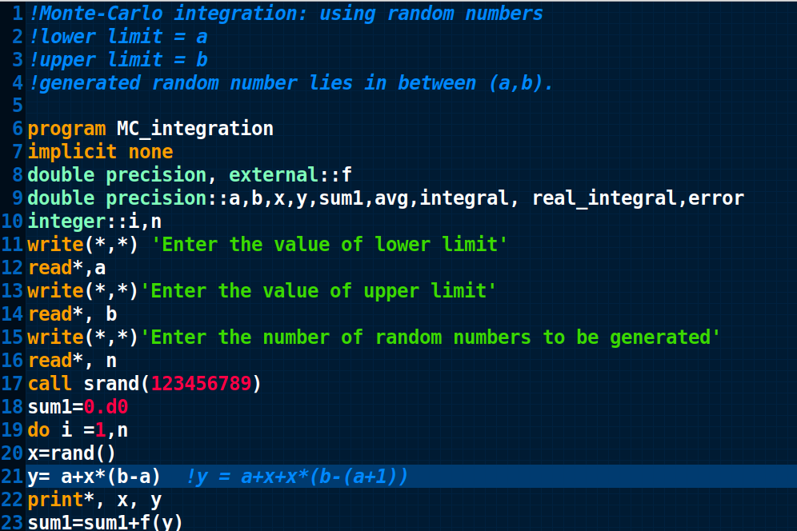
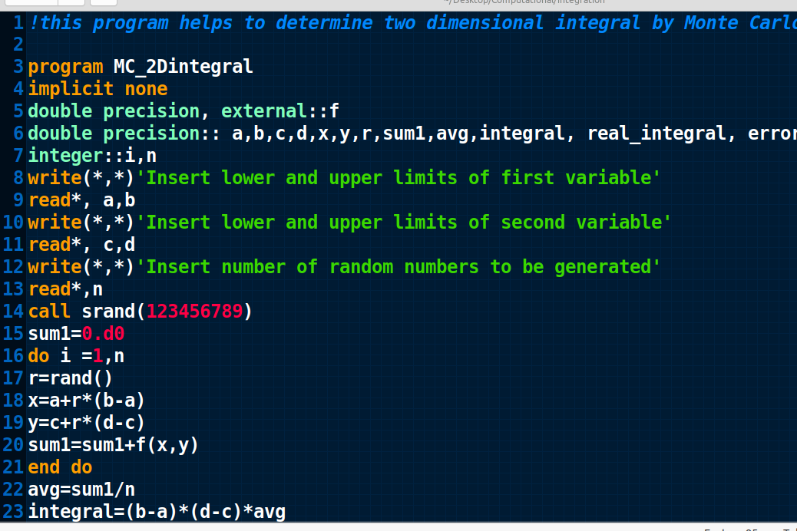
Integration by Monte-Carlo method
1. Integration for limit 0 to 1
2. Integration for other limits
3. Two dimensional integration

